Slide 1
Sequential Circuits III
Counters
CSE 4205: Digital Logic Design
Aashnan Rahman
Junior Lecturer
Department of Computer Science and Engineering (CSE)
Islamic University of Technology

Slide 2
01
Introduction

Slide 3
Introduction
The simplest type of MSI sequential circuit
  Made of one or more flip flops (building block of sequential circuit)
Definition: Basically, a counter changes its state in a prescribed sequence when input pulses are received
  Driven by a clock signal (common input pulse)
Used to count number of pulses/cycles, to measure time and frequency
Basically, we use T flip flop which has the toggling feature (input, T = 1) best suited for counting operation
  J-K flip flop can be used with the toggle property
  S-R or D flip flops also could be used with more complex designs

Slide 4
Types
Broadly categorized as:
  Asynchronous and synchronous counter
  Single and multimode counter
  Modulus counter
All of them has further classifications

Slide 5
02
Types

Slide 6
Synchronous and Asynchronous Counter
Asynchronous Counter
    Simple and straightforward in operation and construction
      It requires minimum amount of hardware
    Each flip flop is triggered by the previous flip flop
      So, the speed of this type of counter is limited
      Settling time of the counter is the cumulative sum of individual settling times of flip flops
    Also known as ripple or serial counter
Synchronous Counter
    Clock pulses are simultaneously applied to all flip flops
      So, settling time is very less than settling time of asynchronous counter
      It is equal to the settling time of a single flip flop
    To increase the speed of the counter, more sophisticated hardware is required
    Also known as parallel counter

Slide 7
Single and Multimode Counter
Modes of counting
    Count-Up
      Content of the counter advances by one with each clock pulse
    Count-Down
      Content of the counter reverses by one with each clock pulse
Single-mode Counter
  Either count-up mode or count-down mode is in operation
Multimode Counter
  Both modes are in operation

Slide 8
Modulus Counter
It is defined by the number of states it is capable of counting.
  To define all states, if n bits are required to represent each state, in total 2^{n} (=N) states are possible (maximum count)
Types:
  Mod-N or Mod-2^{n}
    It can count to 2^{n} (=N)
    If we start counting with 0, it will end at (N-1)
  Mod<N
    It counts less than the maximum count (N)

Slide 9
Asynchronous Counter
All the flip flops are not driven by same clock pulse
    Rather the clock pulse is applied to first (LSB position) flip flop
      Only the flip flop is synchronized with clock signal
    Successive flop flops are triggered by the output of the previous flip flop
      When the state changes from Q=1 to Q=0 for negative edge triggered clock pulse
    Cascading fashion
It has cumulative settling time of all flip flops
    It limits the speed of the counter
    The delay caused by the propagation delay through the flip flops
It causes the ripple through effect to change the states of the flip flops successively
    Signal propagates through this counter in ripple fashion
    So called as ripple counter

Slide 10
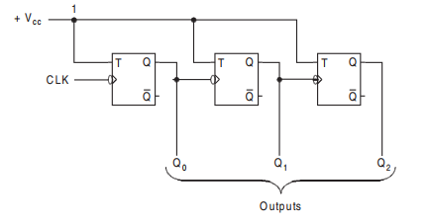
3 bit Asynchronous Up Counter

Slide 11
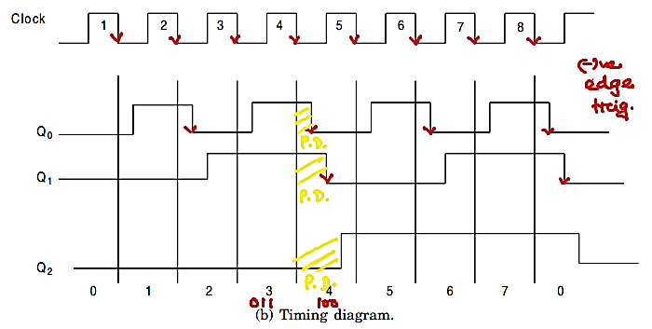
3 bit Asynchronous Up Counter (Timing Diagram)

Slide 12
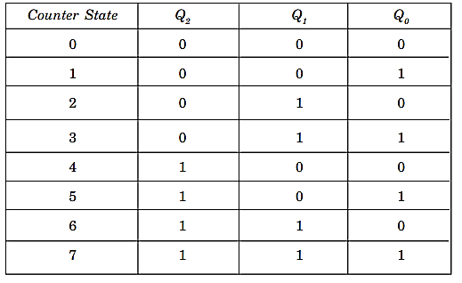
3 bit Asynchronous Up Counter (Count Sequence)

Slide 13
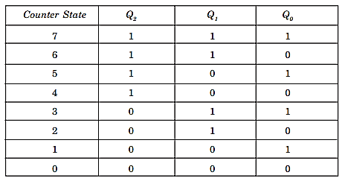
3 bit Asynchronous Down Counter
Counts downward starting from a maximum count of (2^{n}-1) to 0
Application: Count-down timer
There are three different ways to implement…

Slide 14
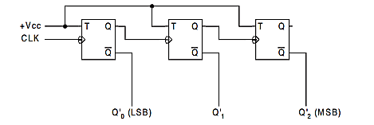
3 bit Asynchronous Down Counter (Way I)
With same circuit as previous, only outputs of the counter may be taken from the complement outputs (Q’) of the flip-flops
  Rather than from the normal outputs (Q) for each flop-flops
Starting count sequence is 111
  With each negative edge of the clock pulse the count sequence will decrease

Slide 15
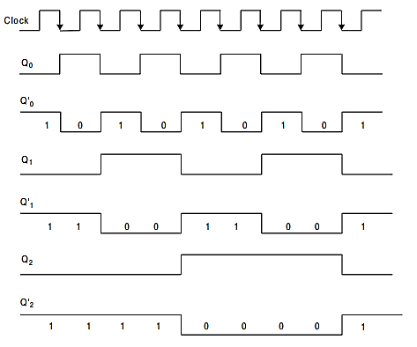
3 bit Asynchronous Down Counter (Way I)

Slide 16
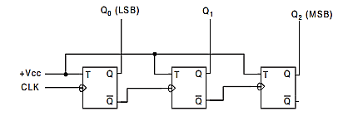
3 bit Asynchronous Down Counter (Way 2)
The circuit will be slightly modified so that the clock inputs of successive flip-flops will be driven by the Q’ output of preceding stages (flip-flops)
  Rather than the Q outputs of previous flop-flops
Starting count sequence is 000
  With first negative edge of the clock pulse, the counter content changes to 111 and decrease accordingly

Slide 17
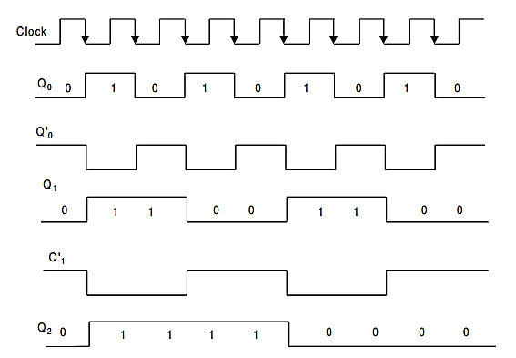
3 bit Asynchronous Down Counter (Way 2)

Slide 18
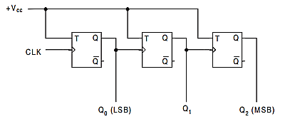
3 bit Asynchronous Down Counter (Way 3)
The circuit will be similar to the up-counter circuit replacing the negative edge triggering flip-flops to the positive edge triggering flip-flops
  Each flip-flop toggles their states with each positive edge transition of the clock pulse
Starting count sequence is 000
  With first positive edge of the clock pulse, the counter content changes to 111 and decrease accordingly

Slide 19
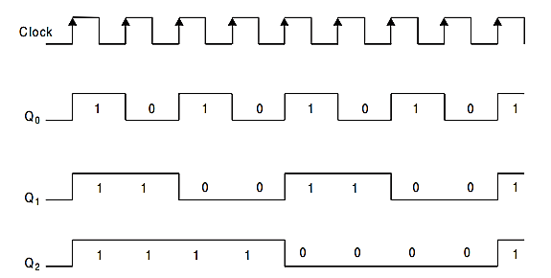
3 bit Asynchronous Down Counter (Way 3)

Slide 20
Asynchronous Up Down Counter
We combine the up and down modes in a single up-down counter
  Count both upward as well as downward
  It is also called the “multimode” counter
In up counter, the subsequent flip-flops are driven by the normal output (Q) of the preceding flip-flops
In down counter, the subsequent flip-flops are driven by the complemented output (Q’) of the preceding flip-flops
  In both cases, the first flip-flop is driven by the original clock pulse generator
The operation of such counter is controlled by up-down controller
  To select the mode – up or down

Slide 21
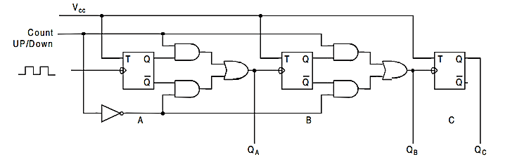
Asynchronous Up Down Counter

Slide 22
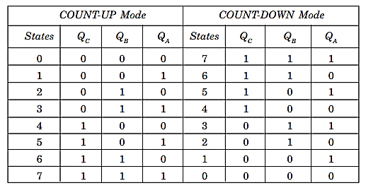
Asynchronous Up Down Counter

Slide 23
Propagation Delay of Asynchronous Up Down Counter

Slide 24
Synchronous Counter
For ripple action, asynchronous counter has larger delay times to set
  This problem will be solved if we use synchronous counter
All flip-flops are clocked synchronously
But, T inputs of different flip-flops could be varied based on necessity

Slide 25
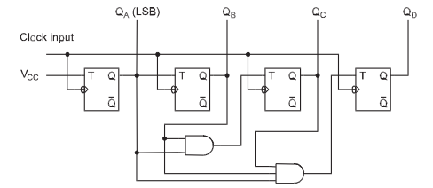
Synchronous Up Counter with Parallel Carry

Slide 26
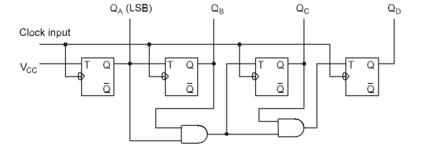
Synchronous Up Counter with Ripple

Slide 27
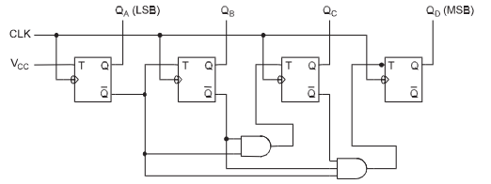
Synchronous Down Counter

Slide 28
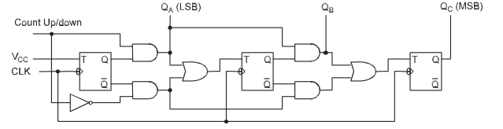
Synchronous Up–Down Counter

Slide 29
03
Design Procedure

Slide 30
Synchronous Counter: Design Procedure
From the problem statement, draw the state diagram that describes the operation of a counter
Derive the state table and circuit excitation table from the state diagram maintaining the count sequence
Find the number of the flip-flops
Determine the flip-flop type and its inputs
Prepare the K-maps to get the simplified expressions for each inputs in term of the outputs and external inputs of flip-flops
Connect the circuit using the flip-flops and other gates corresponding to the simplified expressions

Slide 31
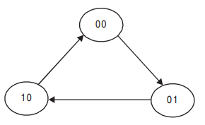
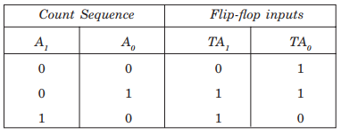
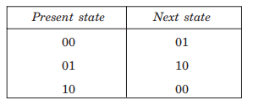
Synchronous Counter: Design Procedure
MOD–3 Counter
State Diagram:
State Table and Circuit Excitation Table:

Slide 32
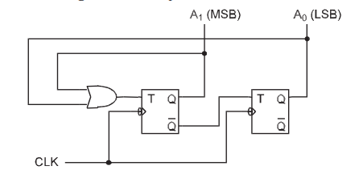
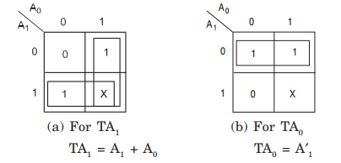
Synchronous Counter: Design Procedure
MOD–3 Counter
K-map for simplification:
Logic Diagram:

Slide 33
Synchronous Counter: Propagation Delay

Slide 34
Synchronous-Asynchronous Counter
Some hybrid counters combines the good feature of these both
  Simplicity of the asynchronous counter and speed of the synchronous counter
  Example: BCD synchronous-asynchronous counter
  Explanation: Self-study
  Comparison between synchronous and asynchronous – Self Study

Slide 35
5
Ring Counter

Slide 36
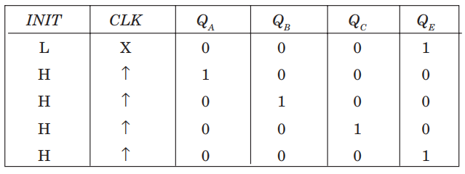
Ring Counter

Slide 37
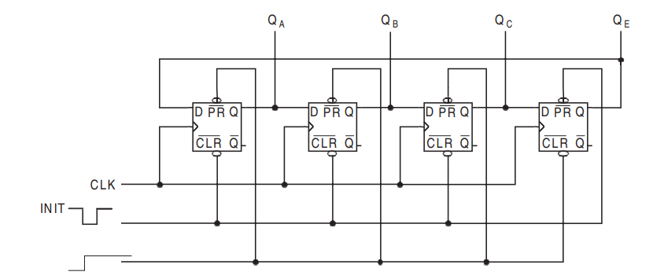
4 Bit Ring Counter with D FF

Slide 38
6
Johnson Counter

Slide 39
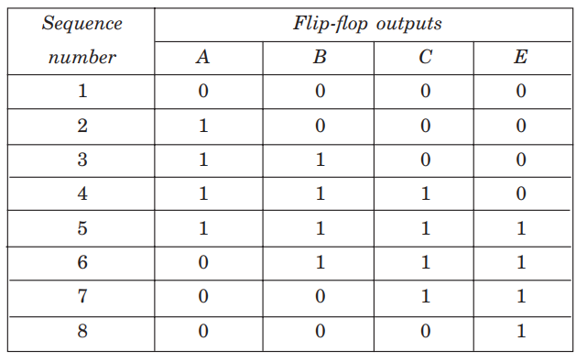
Johnson Counter

Slide 40
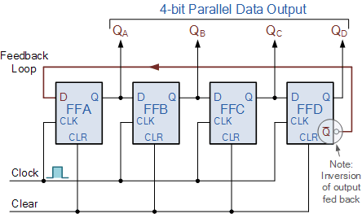
4 bit Johnson Counter with D FF

Slide 41
Thank You !!
Feel free to ask any questions

